Slide 1

Algorithms
Shortest Paths II
Bellman-Ford algorithm
Linear programming and difference constraints
VLSI layout compaction

Slide 2
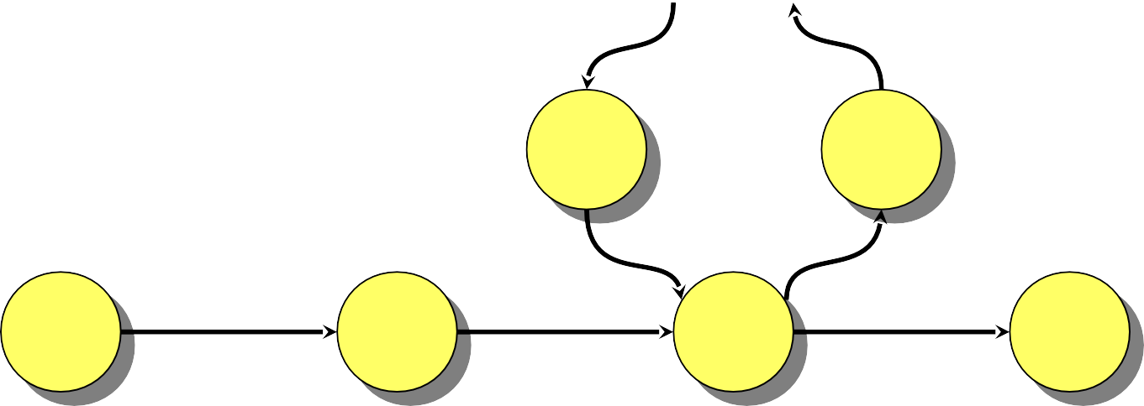
Negative-weight cycles
Recall: If a graph G = (V, E) contains a negative- weight cycle, then some shortest paths may not exist
…
Example:
< 0
u
v

Slide 3
Negative-weight cycles
Recall: If a graph G = (V, E) contains a negative- weight cycle, then some shortest paths may not exist
…
Example:
< 0
u v
Bellman-Ford algorithm: Finds all shortest-path lengths from a source s ∈ V to all v ∈ V or determines that a negative-weight cycle exists.

Slide 4
Bellman-Ford algorithm
d[s] ← 0
for each v ∈ V – {s}
do d[v] ← ∞
initialization
for i ← 1 to |V| – 1
do for each edge (u, v) ∈ E
do if d[v] > d[u] + w(u, v)
then d[v] ← d[u] + w(u, v)
for each edge (u, v) ∈ E
relaxation step
do if d[v] > d[u] + w(u, v)
then report that a negative-weight cycle exists
At the end, d[v] = δ(s, v), if no negative-weight cycles. Time = O(VE).

Slide 5
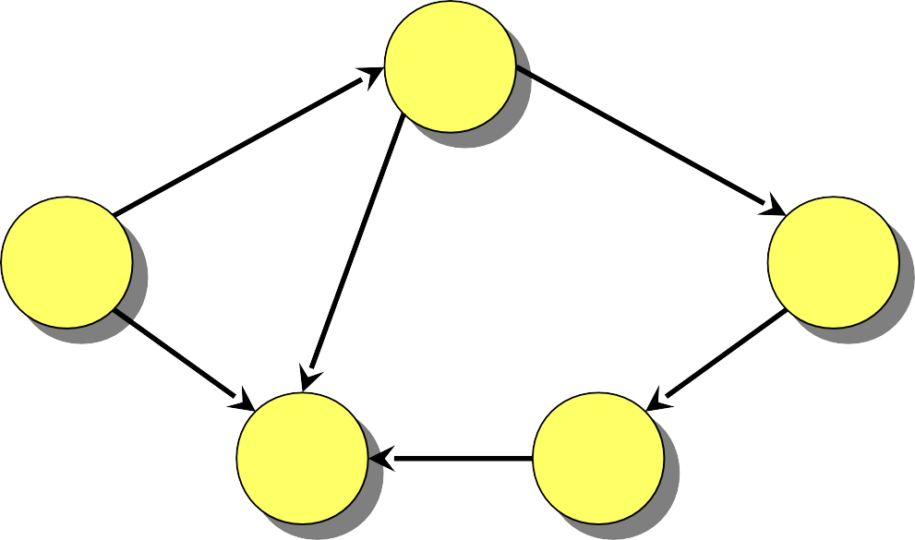
Example of Bellman-Ford
B
2
–1
A
3
2
E
1
4
–3
C
D
5

Slide 6
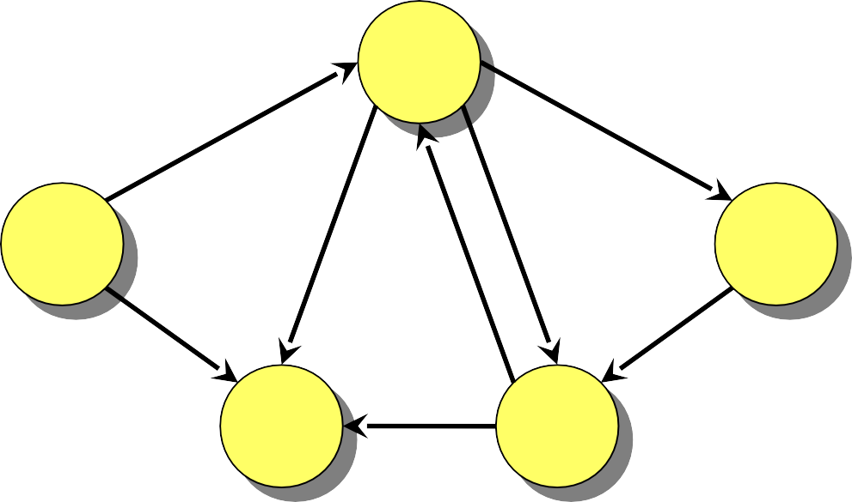
Example of Bellman-Ford
∞
B
–1
2
0
∞
A
3
2
E
1
4
–3
C
∞
D
∞
5
Initialization.

Slide 7
Example of Bellman-Ford
∞
B
1
2
–1
0
∞
7
3
4
3
2
A
1
E
5
4
8
–3
2
C
∞
6
D
∞
5
Order of edge relaxation.

Slide 8
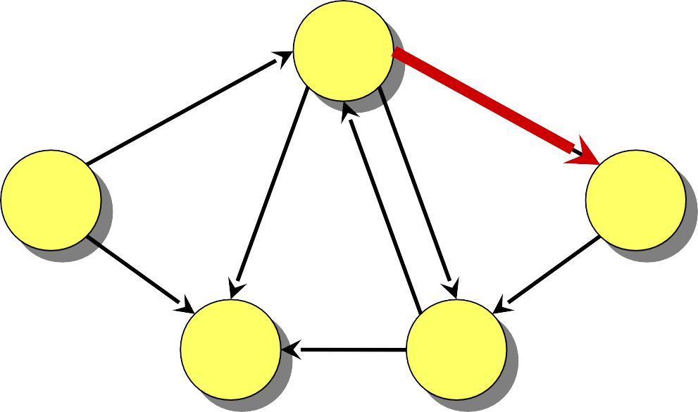
Example of Bellman-Ford
∞
B
1
2
–1
0
∞
7
3
4
3
2
A
1
E
5
4
8
–3
2
C
∞
6
D
∞
5

Slide 9
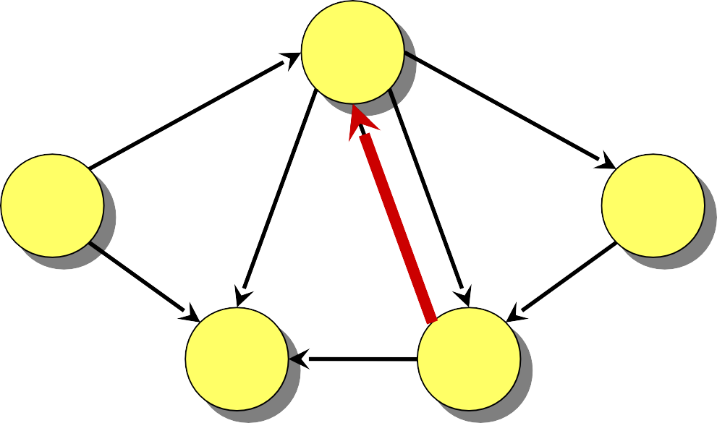
Example of Bellman-Ford
∞
B
1
2
–1
0
∞
7
3
4
3
2
A
1
E
5
4
8
–3
2
C
∞
6
D
∞
5

Slide 10
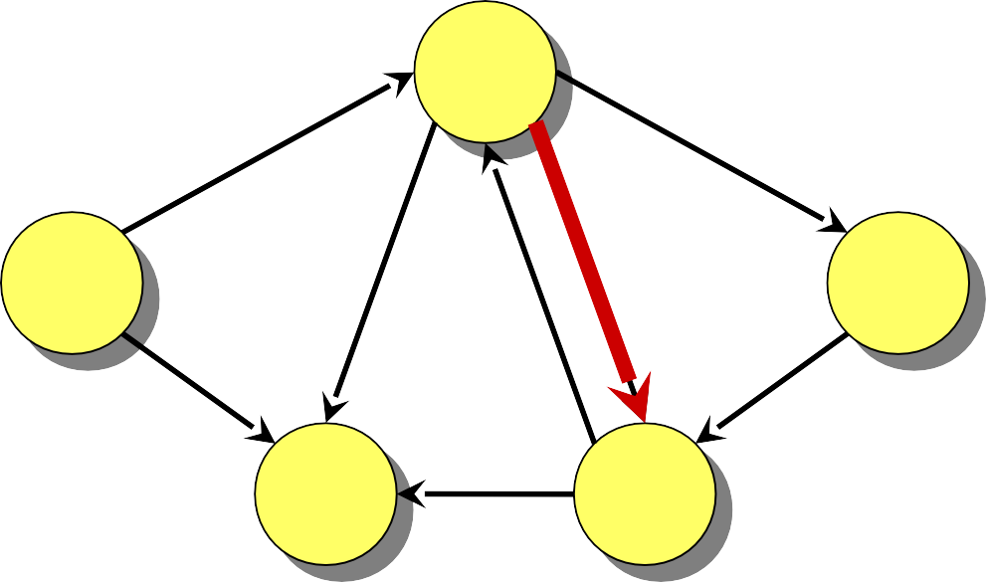
Example of Bellman-Ford
∞
B
1
2
–1
0
∞
7
3
4
3
2
A
1
E
5
4
8
–3
2
C
∞
6
D
∞
5

Slide 11
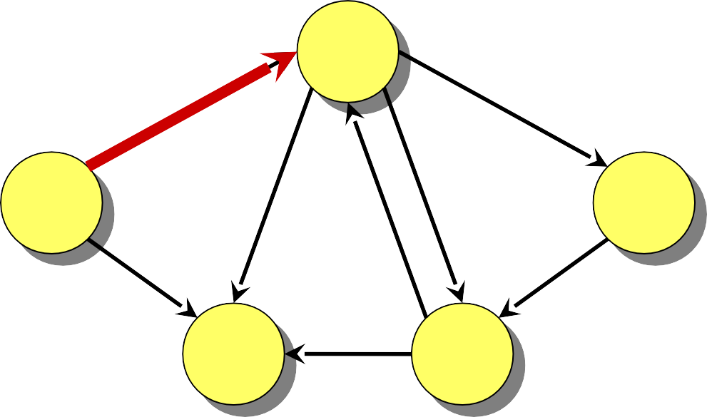
Example of Bellman-Ford
−1
B
1
–1
2
0
∞
7
3
4
3
2
A
1
E
5
4
8
–3
2
C
∞
6
D
∞
5

Slide 12
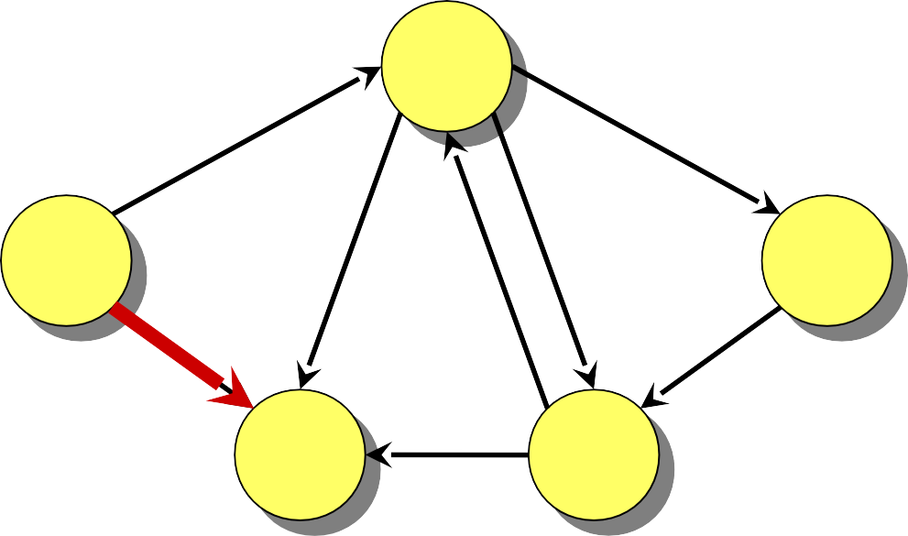
Example of Bellman-Ford
−1
B
1
2
–1
0
∞
7
3
4
3
2
A
1
E
5
4
8
–3
2
C
6
D
∞
5
4

Slide 13
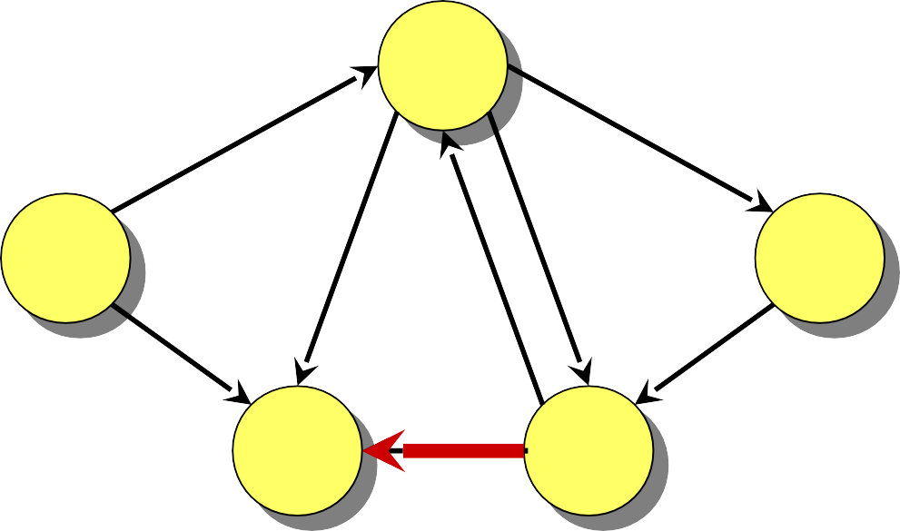
Example of Bellman-Ford
−1
B
1
2
–1
0
∞
7
3
4
3
2
A
1
E
5
4
8
–3
2
C
4
6
D
∞
5

Slide 14
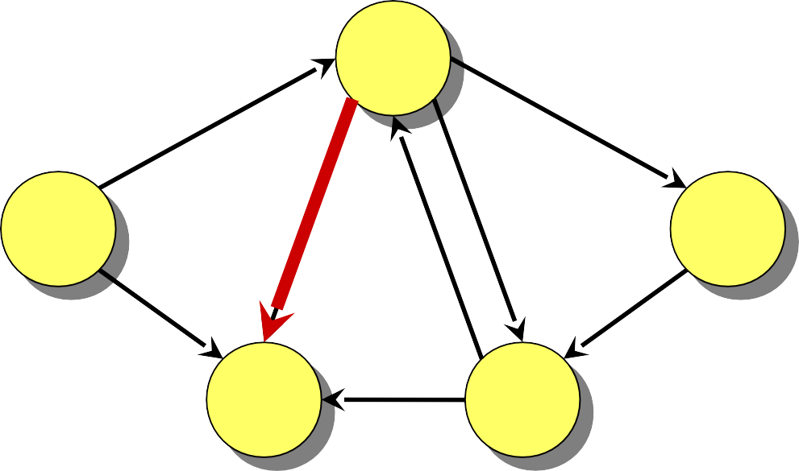
Example of Bellman-Ford
−1
B
1
2
–1
0
∞
7
3
4
3
2
A
1
E
5
4
8
–3
2
C
2
6
D
∞
5
4

Slide 15
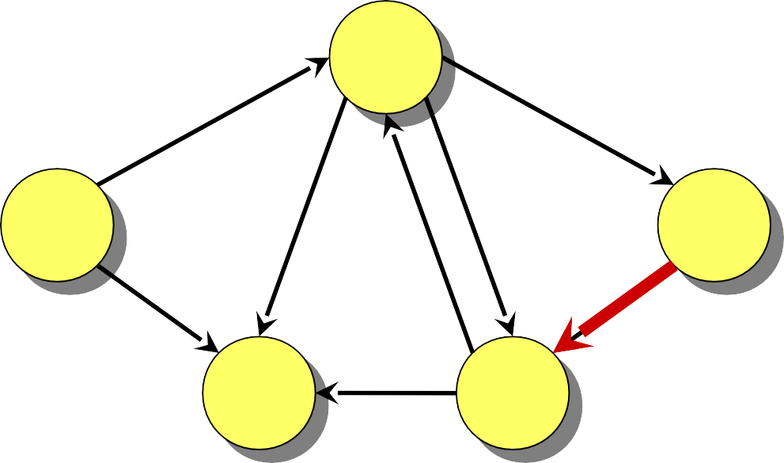
Example of Bellman-Ford
−1
B
1
2
–1
0
∞
7
3
4
3
2
A
1
E
5
4
8
–3
2
C
2
6
D
∞
5

Slide 16
Example of Bellman-Ford
−1
B
1
2
–1
0
∞
7
3
4
3
2
A
1
E
5
4
8
–3
2
C
2
6
D
∞
5
End of pass 1.

Slide 17
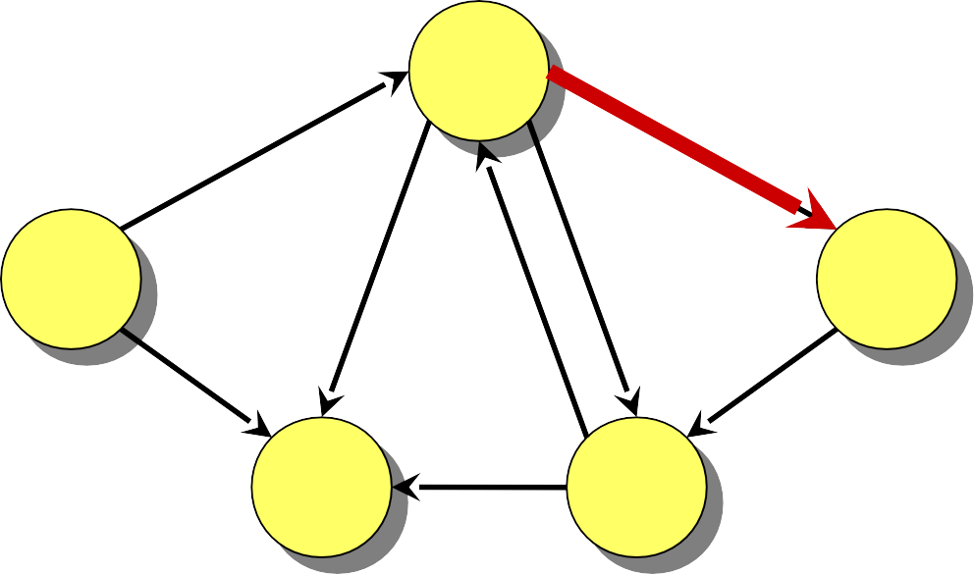
Example of Bellman-Ford
−1
B
1
2
–1
0
1
∞
7
3
4
3
2
A
1
E
5
4
8
–3
2
C
2
6
D
∞
5

Slide 18
Example of Bellman-Ford
−1
B
1
2
–1
0
1
7
3
4
3
2
A
1
E
5
4
8
–3
2
C
2
6
D
∞
5

Slide 19

Example of Bellman-Ford
−1
B
1
2
–1
0
1
7
3
4
3
2
A
1
E
5
4
8
–3
2
C
2
6
D
5
1

Slide 20

Example of Bellman-Ford
−1
B
1
2
–1
0
1
7
3
4
3
2
A
1
E
5
4
8
–3
2
C
2
6
D
1
5

Slide 21
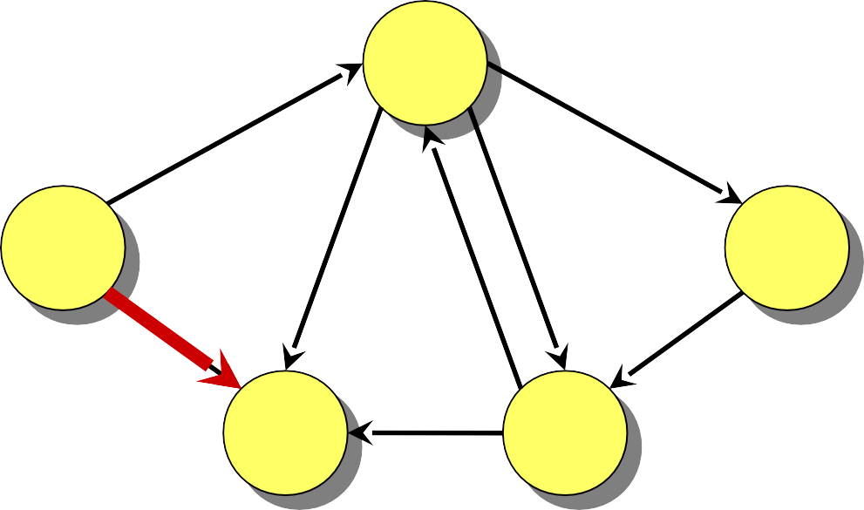
Example of Bellman-Ford
−1
B
1
2
–1
0
1
7
3
4
3
2
A
1
E
5
4
8
–3
2
C
2
6
D
1
5

Slide 22
Example of Bellman-Ford
−1
B
1
2
–1
0
1
7
3
4
3
2
A
1
E
5
4
8
–3
2
C
2
6
D
1
5

Slide 23
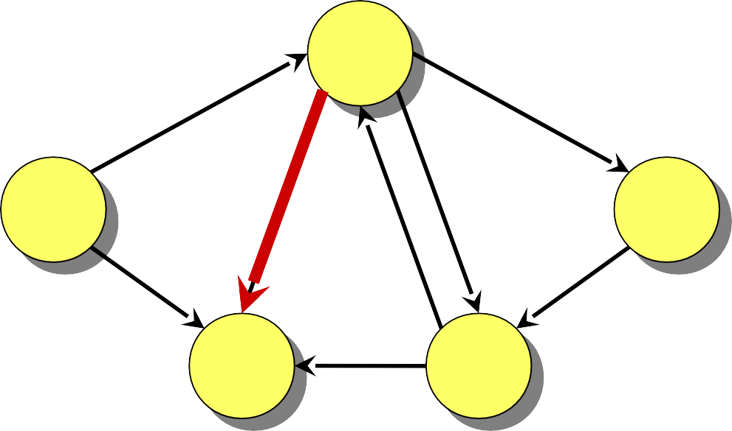
Example of Bellman-Ford
−1
B
1
2
–1
0
1
7
3
4
3
2
A
1
E
5
4
8
–3
2
C
2
6
D
1
5

Slide 24
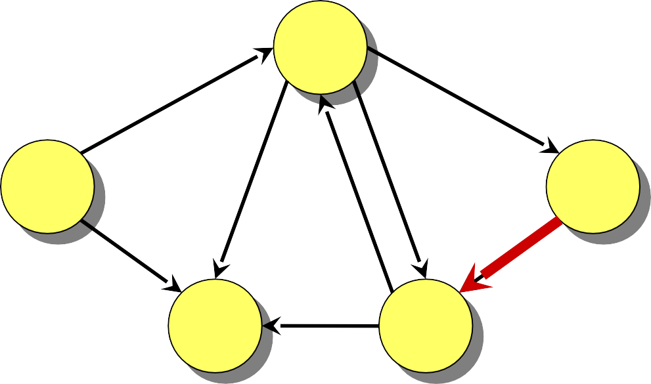
Example of Bellman-Ford
−1
B
1
2
–1
0
1
7
3
4
3
2
A
1
E
5
4
8
–3
2
C
2
6
D
5
1
−2

Slide 25
Example of Bellman-Ford
−1
B
1
2
–1
0
1
7
3
4
3
2
A
1
E
5
4
8
–3
2
C
2
6
D
−2
5
End of pass 2 (and 3 and 4).

Slide 26
Correctness
Theorem. If G = (V, E) contains no negative- weight cycles, then after the Bellman-Ford algorithm executes, d[v] = δ(s, v) for all v ∈ V.

Slide 27
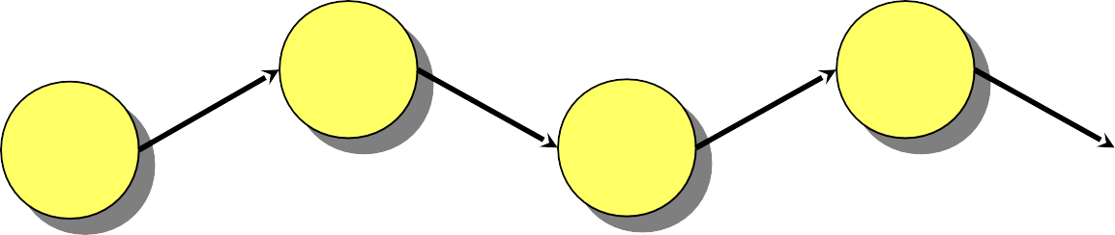
Correctness
Theorem. If G = (V, E) contains no negative- weight cycles, then after the Bellman-Ford algorithm executes, d[v] = δ(s, v) for all v ∈ V. Proof. Let v ∈ V be any vertex, and consider a shortest path p from s to v with the minimum number of edges.
v
s
v v
v
p: v v
1 3
…
k
0 2
Since p is a shortest path, we have
δ(s, v_{i}) = δ(s, v_{i–1}) + w(v_{i–1}, v_{i}) .

Slide 28

Correctness (continued)
v
s
v v
v
1
3
…
k
p: v v
0 2
Initially, d[v₀] = 0 = δ(s, v₀), and d[v₀] is unchanged by subsequent relaxations (because of the lemma from Lecture 14 that d[v] ≥ δ(s, v)).
After 1 pass through E, we have d[v₁] = δ(s, v₁).
After 2 passes through E, we have d[v₂] = δ(s, v₂).
After k passes through E, we have d[v_{k}] = δ(s, v_{k}).

Since G contains no negative-weight cycles, p is simple. Longest simple path has ≤ |V| – 1 edges.

Slide 29
Detection of negative-weight cycles
Corollary. If a value d[v] fails to converge after
|V| – 1 passes, there exists a negative-weight cycle in G reachable from s.

Slide 30
Example of Bellman-Ford
if (d[u]+c(u,v) < d[v])
d[v]= d[u]+c(u,v)
B
2
–1
A
3
2
E
1
4
–3
C
D
5

Slide 31
Example of Bellman-Ford
if (d[u]+c(u,v) < d[v])
d[v]= d[u]+c(u,v)
B
2
–1
A
3
2
E
1
4
–3
C
D
5
Edges:
(A,B), (A,C), (B,C), (B,D), (B ,E), (D,B), (D,C), (E,D)

Slide 32
Example of Bellman-Ford
if (d[u]+c(u,v) < d[v])
d[v]= d[u]+c(u,v)
∞
B
–1
2
0
∞
A
3
2
E
1
4
–3
C
∞
D
∞
5
Edges:
(A,B), (A,C), (B,C), (B,D), (B ,E), (D,B), (D,C), (E,D)
Pass 1:
Initialization.

Slide 33
Example of Bellman-Ford
if (d[u]+c(u,v) < d[v])
d[v]= d[u]+c(u,v)
−1
B
–1
2
0
1
A
3
2
E
1
4
–3
C
4, 2
D
1, −2
5
Edges:
(A,B), (A,C), (B,C), (B,D), (B ,E), (D,B), (D,C), (E,D)
After the end of Pass 1

Slide 34
Time complexity : O(E*(|V|-1))
simplify → O(EV)
For a complete graph number of edges: {n(n-1)}/2
Number of vertices : n
From the previous eq:
O(n³)

